Slide 1
BANK LOAN ANALYSIS
Data Analyst Portfolio Project
End-to-End Analysis using SQL & Power BI
Name: Shraddha Dhanawade
Tools: MS SQL Server | Power BI | Excel

Slide 2
Business Problem
Problem Statement
Banks need to:
Track loan performance
Identify good vs bad loans
Monitor monthly trends
Improve risk assessment & profitability
Objective:
To analyze loan data and build interactive dashboards that support data-driven lending decisions.

Slide 3
Dataset Overview
Dataset Details
Loan application data
Customer financial details
Loan status & repayment information
Time-based loan metrics
Records: 38576
Data anonymized for analysis purposes

Slide 4
Tools & Technologies
MS SQL Server
  Database creation
  SQL queries
  KPI calculations
Power BI
  Data cleaning (Power Query)
  Data modeling
  DAX measures
  Interactive dashboards
Excel
  Initial data inspection

Slide 5
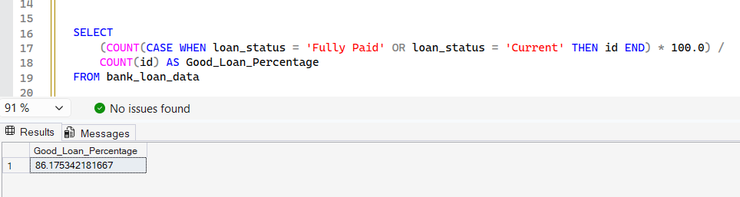
SQL Data Processing
Loan data processed using MS SQL Server
KPIs calculated: Loan Applications, Funded Amount, Amount Received
MTD & MoM performance analysis
Loans classified as Good (Fully Paid / Current) and Bad (Charged Off)
Aggregated analysis by status, state, purpose, term & employment

Slide 6
KPIs Defined
Key Performance Indicators (KPIs)
Total Loan Applications
Total Funded Amount
Total Amount Received
Average Interest Rate
Average Debt-to-Income Ratio (DTI)
MTD & MoM performance tracking

Slide 7
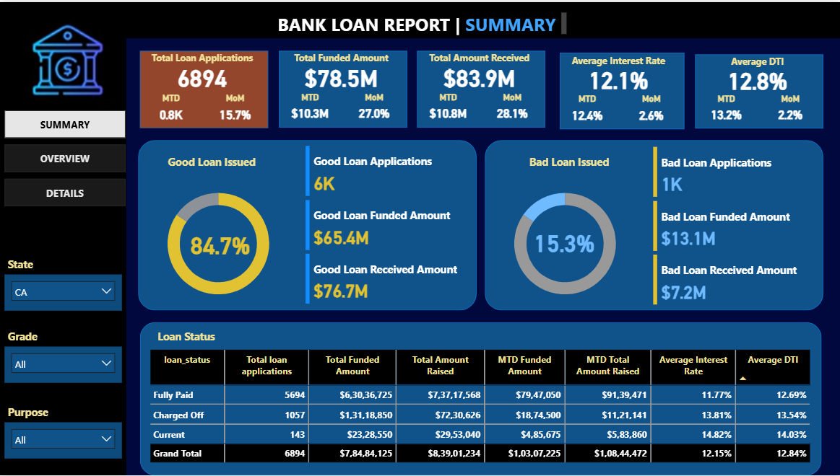
Dashboard 1 – Summary

Slide 8
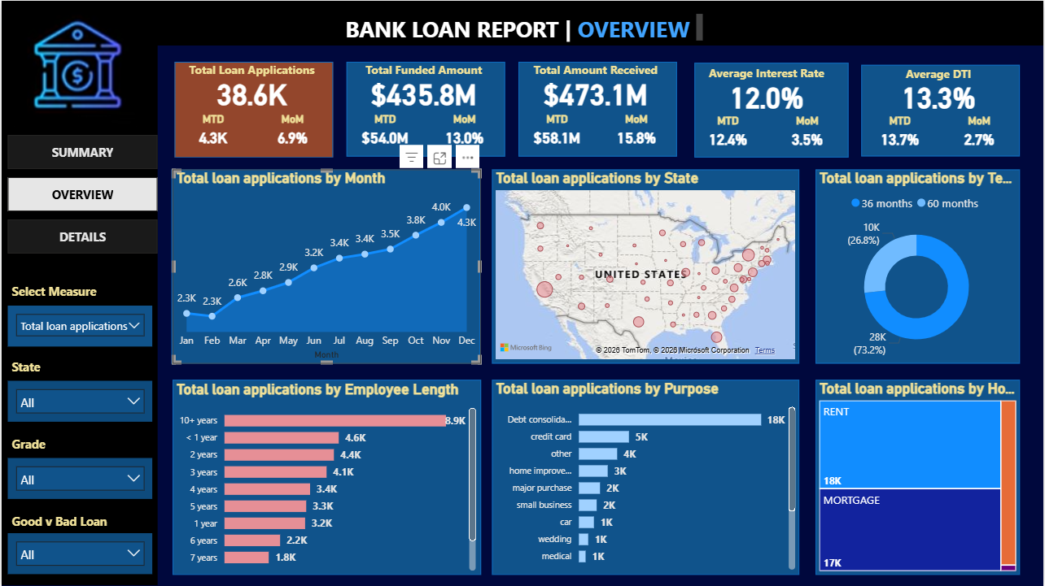
Dashboard 2 – Overview

Slide 9
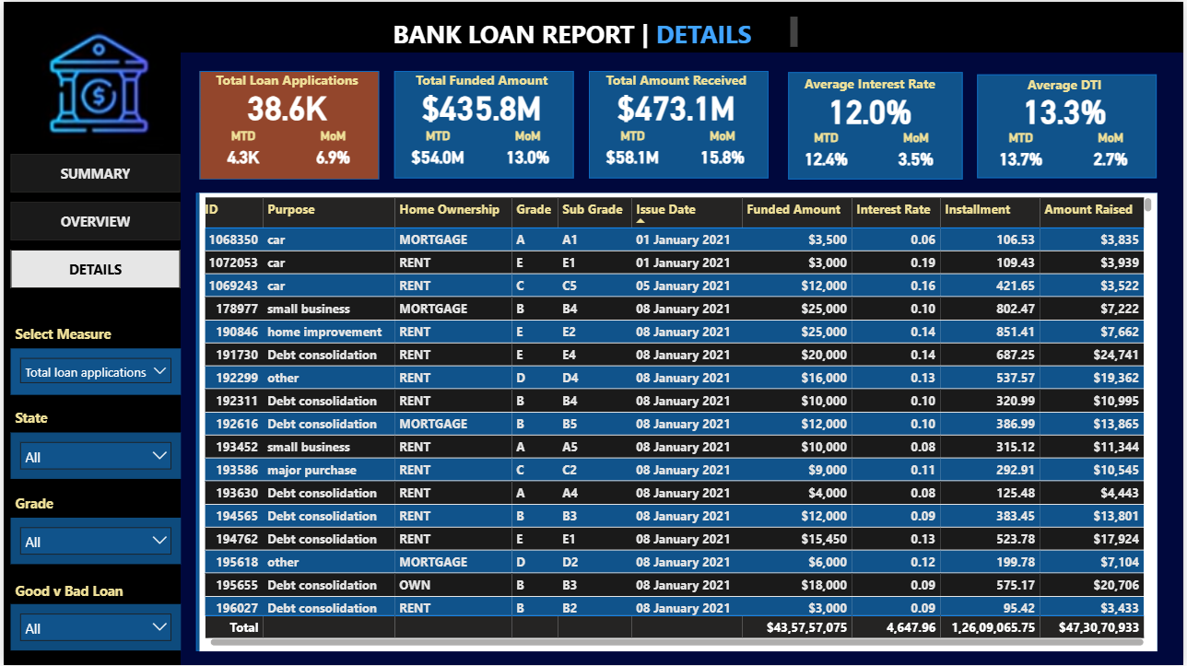
Dashboard 3 – Details

Slide 10
Key Insights
Insights Generated
Majority loans issued for debt consolidation
Certain states show higher default risk
Longer employment length → better repayment
High DTI correlates with bad loans

Slide 11
Conclusion & Impact
Business Impact
Improved loan monitoring
Risk identification support
Faster decision-making
Scalable dashboard solution
Future Enhancements
Credit score integration
Predictive default model
Automation via scheduled refresh

